Slide 1
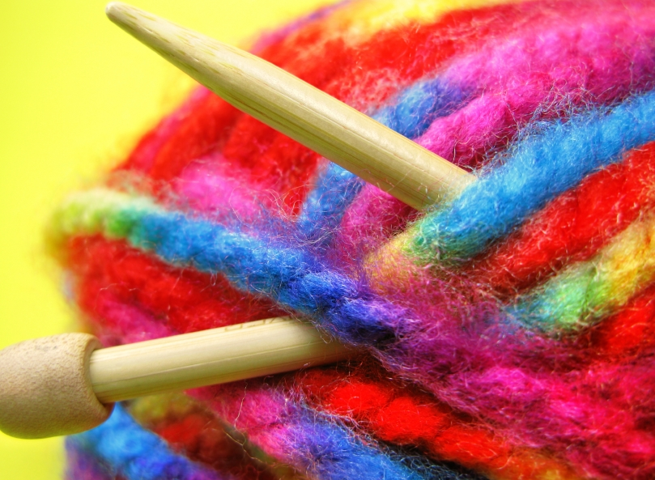
GETTING THE RIGHT HAND TO WORK WITH THE LEFT
Researching Knitting to Facilitate Change and Improve Wellbeing
Betsan Corkhill

Slide 2
BACKGROUND
Gave up physiotherapy in 2002
I became a freelance Production Editor
Most letters talked about using knitting as therapy
Large numbers of people from around the world
Motivation / activity from the arm chair – spark and interest in the world
Knitters started sending me their stories
Set up Stitchlinks www.stitchlinks.com in 2005
Approached Pain Clinic, Royal United Hospital in Bath 2006

Slide 3
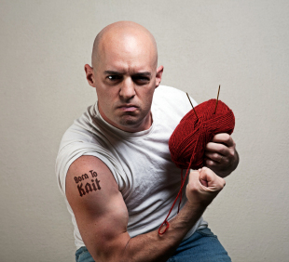
THE ‘K’ WORD

Slide 4
KNITTING =
PATTERNS OF MOVEMENT
ENRICHED ENVIRONMENT
SOCIAL ENGAGEMENT
Bilateral
Coordinated
Cross midline
Repetitive
Rhythmic
Automatic
Creativity
Contribution
Mastery of a skill
Regular Novelty
Reward / Success
Fun / Play
Relaxation
Calm / Self Soothing
Enjoyment of Solitude
Flow
Refocusing attention
Control
Visual Stimulation
Tactile Stimulation
Emotional Stimulation
Community
Friendship
Support
Belonging
Easy Banter
Raucous Laughter
Fun / Play with others
Experimentation
Eye contact…..or not
+
±
HAND POSITION
Increases personal space
Provides a buffer

Slide 5
+ PORTABILITY

Slide 6
INTERACTIONS - SYNERGY
The rhythmic, repetitive movements provide a self-soothing tool to manage emotions of attending a group
Hand position increases personal space – a buffer
The automatic nature encourages conversation, laughter and easy banter
The activity makes the group work on several levels – enables participation

Slide 7
CORE ISSUES + CONTEXT
Social isolation / loneliness
Lack of rewarding occupation
Low self-esteem / confidence / feeling worthless
Worry / fear / stress
Loss of identity / identity issues
FEED EACH OTHER!

Slide 8
SURVEY
3,514 valid responses from 31 countries in less than 2 weeks
The more frequently people knit the happier and calmer they feel
81% of respondents with clinical depression said they felt happier with 54% feeling happy or very happy
Texture and colour – tactile experience results in an emotional response
Notes:
Supported by work I’m doing with patients
So we’re coming back to the hands and the importance of information we get from them

Slide 9
TRANSFERRABLE SKILLS
Looking forward / visualisation , imagination
Patience, Perseverance, Planning, Goal Setting
Pacing
Mistakes can be undone – they’re not catastrophic

Slide 10
“Antidepressants numb all my senses. Knitting makes me happy.”
“Knitting means, I can subjugate pain to the status of discomfort. The movement needed by knitting seems to create a state of mind in which I’m more able to downgrade pain to a background feature.”

Slide 11
THE CREATIVE PROCESS AND HEALTH
There’s something important about being actively creative as opposed to being a passive recipient of a destructive force
SUCCESS NEEDS ACTION!
Current Healthcare systems and attitudes encourage passivity
“This is the first constructive thing I’ve done for years!”

Slide 12
THE CREATIVE PROCESS AND HEALTH
People with health problems need a safe, structured framework within which to operate. Where reward is achievable
Knitting enables us to deliberately nurture creative thought and ability within a safe structure
Happy to experiment

Slide 13
FINDING A COMMON GROUND
Arts and Science working together to improve wellbeing
Building a case – the art of science and the science of art

Slide 14
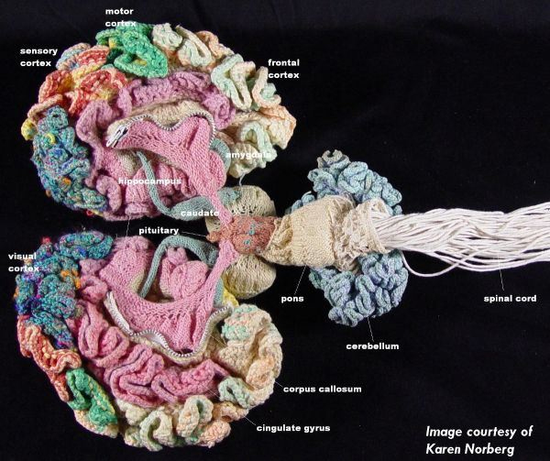

Slide 15
BODYMIND+SPIRIT
+ENVIRONMENT
Not enough to simply treat symptoms
The whole person +
The context within which they experience ill health
Changing context can change their experience and symptoms

Slide 16
THE REWARD SYSTEM
Modern society lacks effort-based activity, so the reward system goes into decline - Professor Kelly Lambert, Randolph-Macon College Virginia
Activities involving the hands which have a tangible end product may stimulate the reward system - Professor Kelly Lambert, Randolph-Macon College Virginia
Destructive addictions – binge eating, smoking, alcohol drugs
Knitting keeps the hands and mind busy but may also replace a destructive addiction with a constructive one in terms of chemical release and time spent
MOTIVATION FOLLOWS ACTION

Slide 17
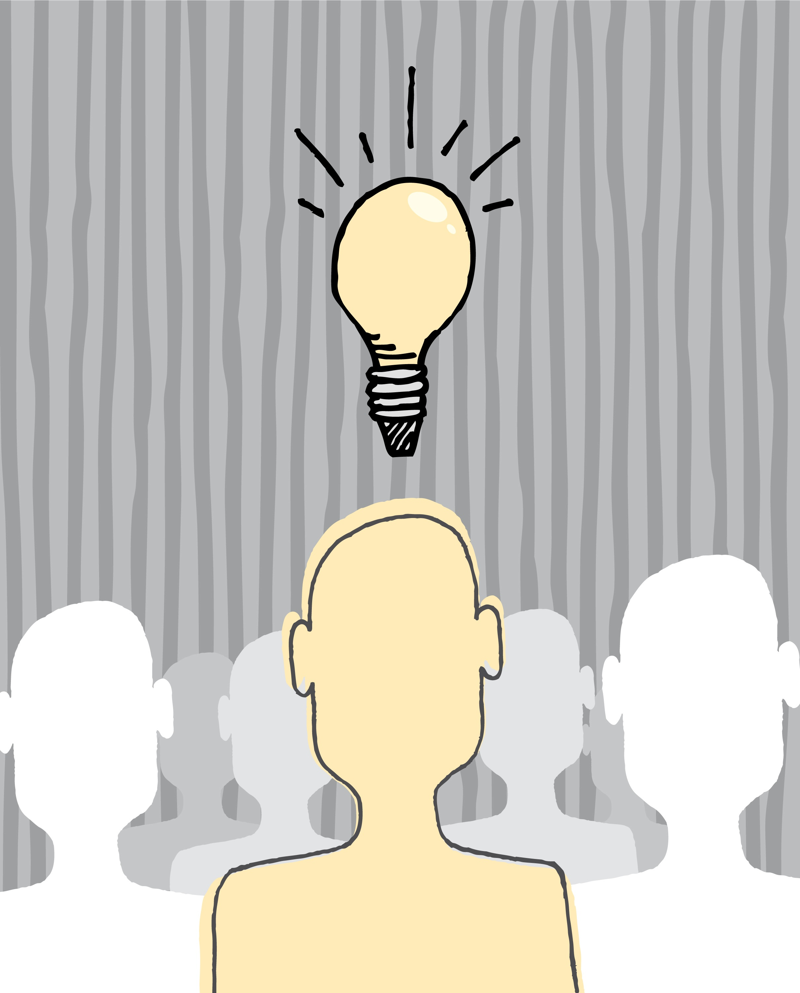
SUCCESS!
Excitement, Pride, Joy, Curiosity, Anticipation, Happiness, Affection
I CAN do something!
Looking forward
PERSPECTIVE
CHANGE
SUCCESS!

Slide 18
SOCIAL ENGAGEMENT
Loneliness and isolation increase the pain experience. The feeling of loneliness sensitises the nervous system and is as destructive as smoking 15 cigarettes a day – John Cacioppo
Right type of social contact – emotional and social loneliness
Social contact can ease pain related to nerve damage by reducing inflammation. "We believe that socially isolated individuals are physiologically different from socially paired individuals, and that this difference seems to be related to inflammation.” – Professor Courtney deVries, Adam Hinzey, Ohio State University
Active social engagement plays an important part in preventing dementia – 40% lower chance of developing dementia if you stay mentally active and socially engaged – Michael Valenzuela, University of Sydney
The more you can engage in this sort of social contact the easier it will become to tune up the body’s natural healing system

Slide 19
NEUROPLASTICITY
The brain and nervous system changes with every experience you have
Changes are reversible
It’s possible to exploit plasticity to treat
New brain cells can be born and new neural pathways created even in elderly people
Corner stones – Novelty, diet, CV exercise

Slide 20
KNITTING =
PATTERNS OF MOVEMENT
ENRICHED ENVIRONMENT
SOCIAL ENGAGEMENT
Bilateral
Coordinated
Cross midline
Repetitive
Rhythmic
Automatic
Creativity
Contribution
Mastery of a skill
Regular Novelty
Reward / Success
Fun / Play
Relaxation
Calm / Self Soothing
Enjoyment of Solitude
Flow
Refocusing attention
Control
Visual Stimulation
Tactile Stimulation
Emotional Stimulation
Community
Friendship
Support
Belonging
Easy Banter
Raucous Laughter
Fun / Play with others
Experimentation
Eye contact…..or not
+
±
HAND POSITION
Increases personal space
Provides a buffer

Slide 21
IS KNITTING DIFFERENT?
PATTERNS OF MOVEMENT
Bilateral
Coordinated
Cross midline
Repetitive
Rhythmic
Automatic
HAND POSITION
Increases personal space
Provides a buffer

Slide 22
THE MOVEMENTS: BILATERAL
“I don’t know what it is, but I feel different. I’ve been able to go out into crowds, or the supermarket and not feel as if I’m going to bump into things.” “I feel as if I know where I am in space.”

Slide 23
THE MOVEMENTS: BILATERAL
Do the movements change / normalise spatial awareness?
Do they change the ‘sense of self’?
Could they be changing brain maps?
Bilateral, rhythmic movements appear to facilitate a meditative state more readily than unilateral ones

Slide 24
THE MOVEMENTS: CROSS MIDLINE
Co-ordinated, bilateral movements that cross midline take up a lot of brain capacity
The midline is significant – an important reference point
Gian Domenico Iannetti and Lorimer Moseley

Slide 25
THE MOVEMENTS: REPETITIVE
Repetitive movements in animals enhance the release of serotonin – Dr Barry Jacobs, Princetown University
Many ancient cultures have tools that involve repetitive hand movements to induce a meditative-like state or to calm eg worry beads, rosary

Slide 26
THE MOVEMENTS: RHYTHMIC
Facilitate a meditative-like state
Facilitates a sense of deep relaxation
Instantaneously familiar, calming, relaxing
Rhythmic, repetitive movements are often used instinctively to deal with stress or trauma
Knitting could enable a wider population to experience the benefits of regular meditation, including children, the elderly and learning disabled

Slide 27
THE MOVEMENTS: AUTOMATIC
Appear to ‘get under the radar’ of the pain system – Fear of movement doesn’t kick in as readily
Can automatic movement facilitate access to the subconscious?
Does it interfere with rumination?
Gives the mind a break from the constant chitter-chatter between the subconscious and conscious
Facilitate intimate conversation - ? Switches off self monitoring

Slide 28
VISUO-SPATIAL MOVEMENT
Performing a repetitive visuo-spatial task during or shortly after a traumatic event significantly reduces the risk of flashbacks. The study recommended further work be done on knitting and worry beads. – Dr Emily Holmes, Dr Catherine Deeprose, Oxford
Those with PTSD report that knitting significantly cuts down their symptoms even a long time after the event. It enables them to think through dark thoughts without being stressed or upset by them
Incidence of traumatic memories and nightmares are reduced
Is there a link with EMDR?

Slide 29
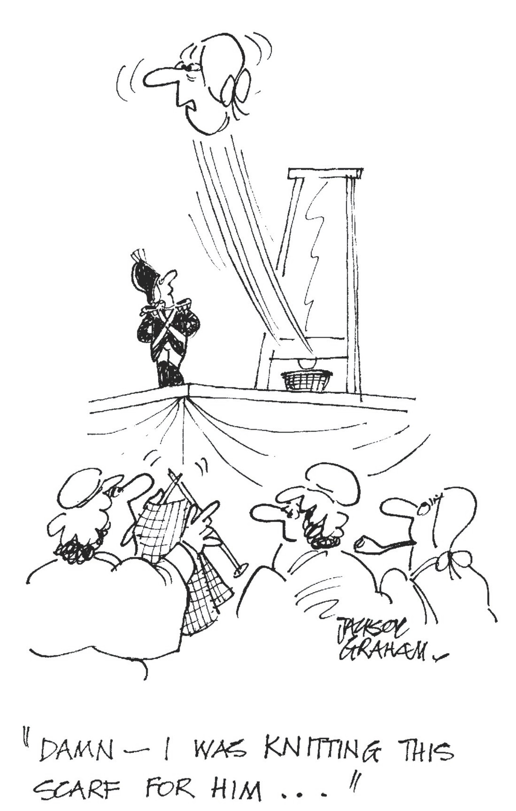
MADAME DEFARGE AND PTSD?
Cartoonstock

Slide 30
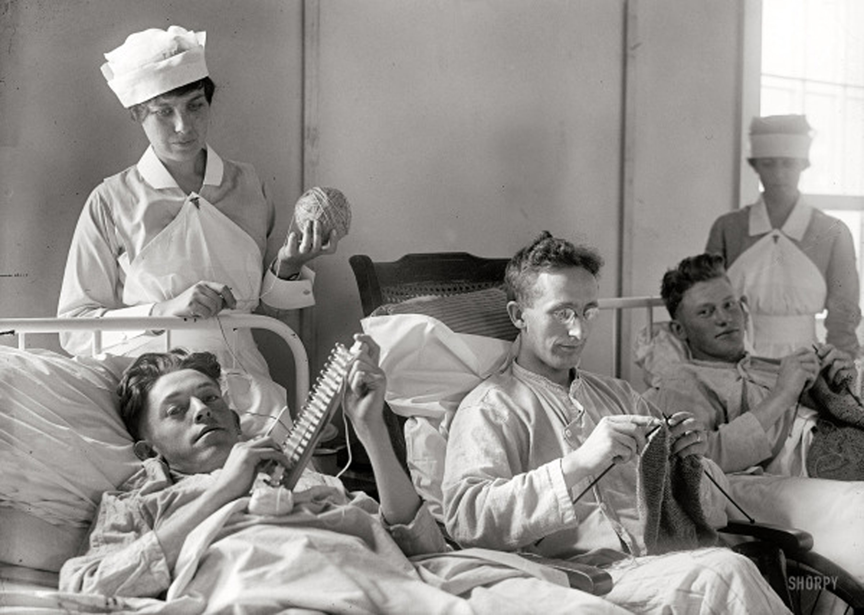

Slide 31
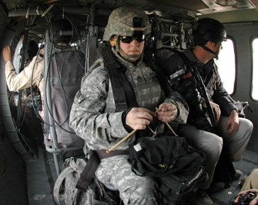

Slide 32
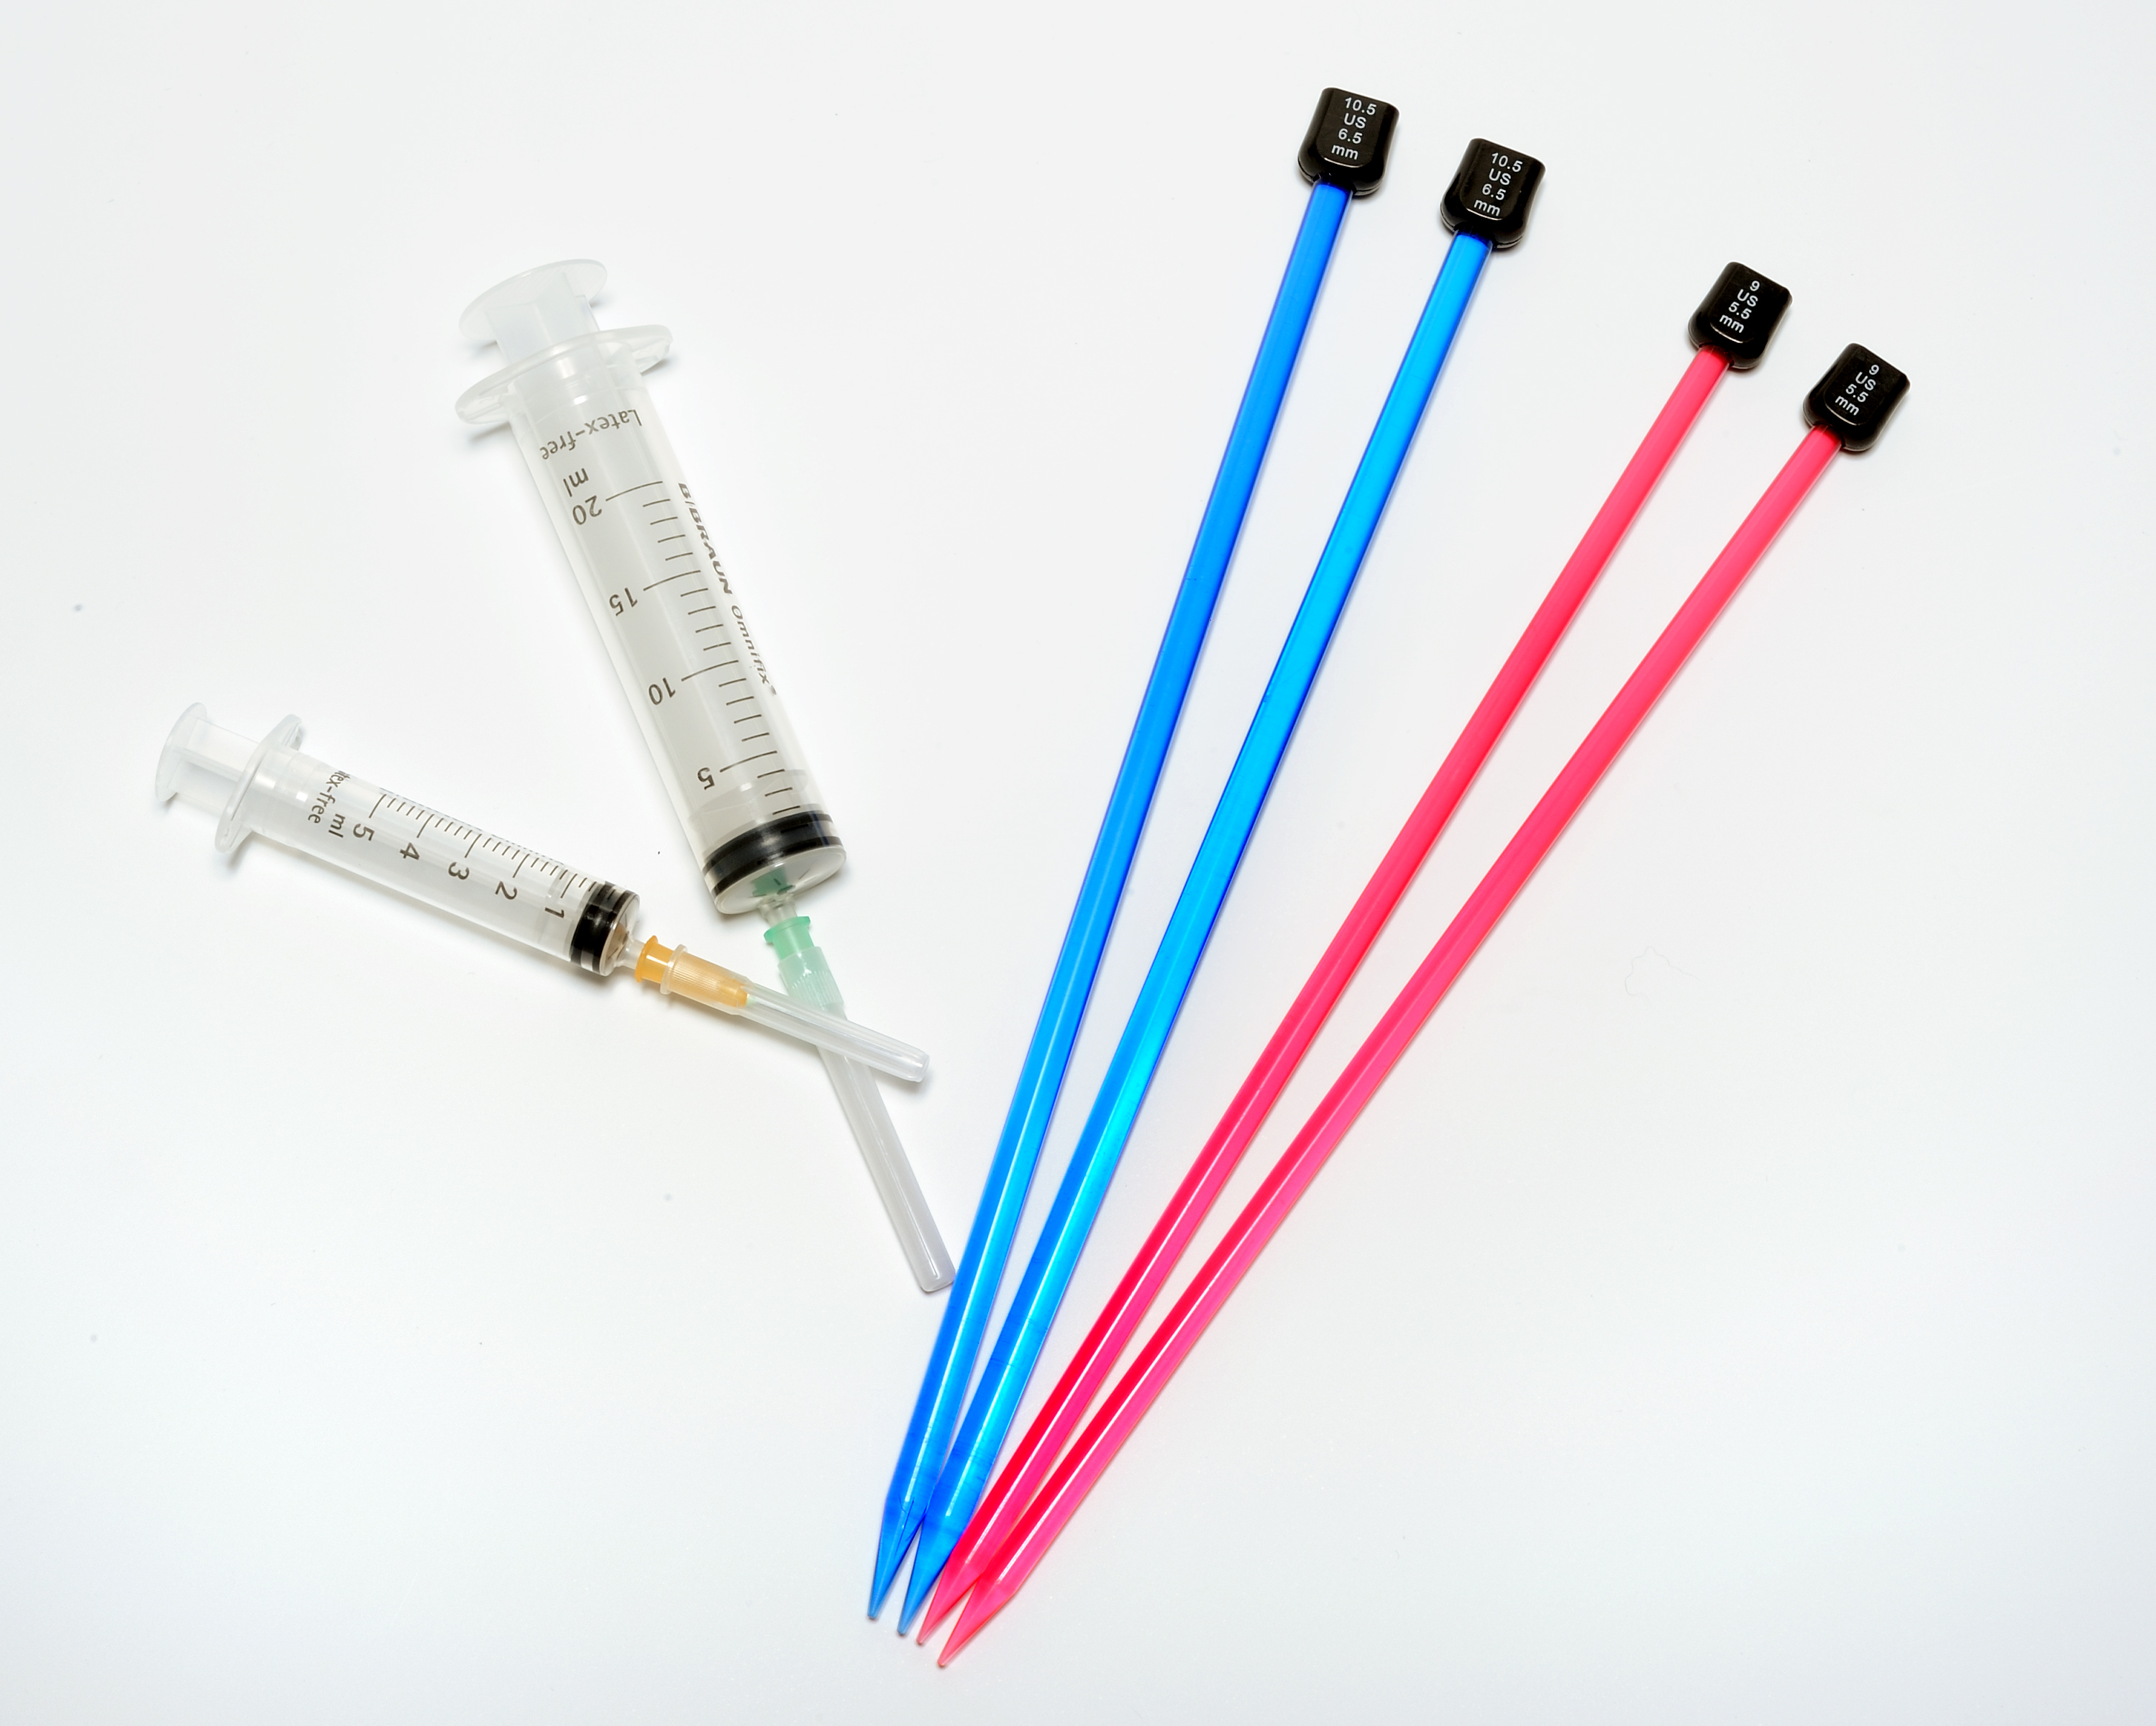
KNITTING IN THE PAIN CLINIC
Whole-person approach

Slide 33
WHY KNITTING FITS IN
Learning process involves no wasted materials
Deliverable in kit form to the arm chair
Not messy to set up or clear up
Requires no artistic talent – reward attainable by all
Cuts across class, culture, educational background
Can be learnt / reinforced from DVDs, Books, YouTube

Slide 34
Pain is a construct / output of the brain
PAIN FACTS
All pain is very real

Slide 35
PAIN IN THE BRAIN
No such things as pain signals
Attention
Interpret
Threat – constructs and outputs pain
Context – past experience, current state

Slide 36
The pain experience is heavily dependent on context
PAIN FACTS
Changing the context will change the pain experienced

Slide 37
PAIN FACTS
Changing the context can change pain
Unoccupied people, experience more pain
Low mood, lonely - experience more pain
Thoughts and beliefs are nerve impulses – stress, worry
Sit doing nothing, the brain declines
USE IT OR LOSE IT!

Slide 38
The brain can’t focus on two things at a time
Distraction is the most powerful analgesic we know of
Managed distraction gives people control

Slide 39
VOLUME CONTROL
The brain is able to send signals down the spinal cord to turn down the volume of those alarm signals

Slide 40
THE TIME IS RIGHT!
1 in 5 people suffer chronic pain Pain Coalition
1 in 3/5 people suffer from depression Mind
90% of medical conditions are caused or exacerbated by stress American Institute of Stress
Half of older people in the UK (5 million +) say the TV is their main form of company (Harrop and Jopling, 2009)
4% of pre-schoolers in the US diagnosed with clinical depression. 80,000 children in UK NICE
Pre-school aged children are the fastest growing age-group being prescribed anti-depressants NHMA

Slide 41
Knitting creates strong, resilient flexible fabric…
Therapeutic Knitting seeks to create strong, resilient flexible minds in the process.
www.stitchlinks.com

Slide 42
KNITTING =
PATTERNS OF MOVEMENT
ENRICHED ENVIRONMENT
SOCIAL ENGAGEMENT
Bilateral
Coordinated
Cross midline
Repetitive
Rhythmic
Automatic
Creativity
Contribution
Mastery of a skill
Regular Novelty
Reward / Success
Fun / Play
Relaxation
Calm / Self Soothing
Enjoyment of Solitude
Flow
Refocusing attention
Control
Visual Stimulation
Tactile Stimulation
Emotional Stimulation
Community
Friendship
Support
Belonging
Easy Banter
Raucous Laughter
Fun / Play with others
Experimentation
Eye contact…..or not
+
±
HAND POSITION
Increases personal space
Provides a buffer

